Slide 1
Development of ITS in New Zealand and an Overview at Current AV trials
Mohammed Hikmet
President – ITS New Zealand mhikmet@hmi.co.nz

Slide 2
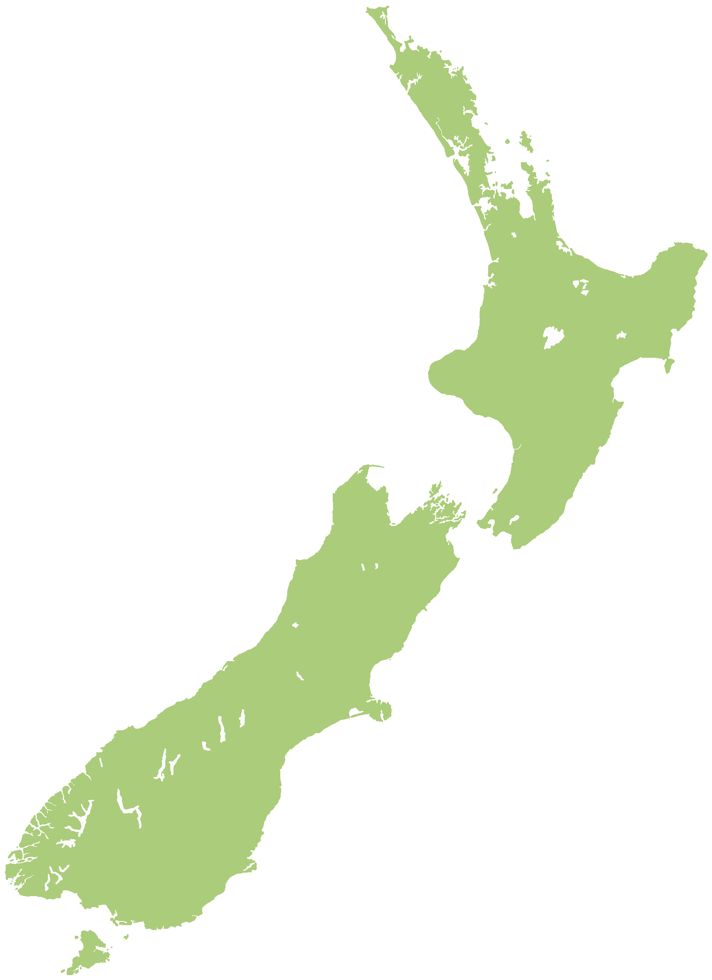
"This country of 4.5 million people has started to churn out some awfully polished, extraordinary products... They're world-class technological achievements - the work of a well-educated, creative people bent on competing on the world stage"
-Ashlee Vance, American business columnist, author of “Elon Musk: Tesla, Space X, and the Quest for a Fantastic Future”

Slide 3
Mobility Marketplace
New Zealand Transport Agency
“RideMate is a world leading real-time mobility app, providing a range of transport information via a free and open marketplace"

Slide 4
Unmanned Aircraft Management
Airways
“We’re responsible for controlling all air movements across 30 million square kilometres of airspace in New Zealand and over the Pacific, handling over 1 million air traffic movements a year"

Slide 5
Personal Air Transport
Zephyr Airworks / Kittyhawk
“What if flying across town was as easy as hopping in a rideshare?”

Slide 6
Paxston Electric Vehicles
New Zealand Post
“NZ Post has introduced 500 electric vehicles into its delivery fleet to reduce the carbon emissions of every parcel it delivers. It now has the biggest electric vehicle fleet in New Zealand"

Slide 7
Mohammed Hikmet
President – ITS New Zealand mhikmet@hmi.co.nz

